Slide 1

OS Structure
Computer System Principles, Fall 2020 (IPADS, SJTU)
Simplify the kernel
Yubin Xia

Slide 2
Previously on CSP
Why learn system? For fun and profit
Case: guess a password by timing attack
Case: guess a PIN by motion sensor
KISS: worse is better
Case: interrupt during system call, return error to user?
Case: MapReduce. A major step backwards?
KISS: the price
Case: ShellShock! Text stream as interface

Slide 3
Previously on CSP
KISS in kernel
Case: micro-kernel VS. monolithic kernel
Case: Exokernel

Slide 4

Vasa: Sink on the first sail

Slide 5
Goals of Operating System
From user
Easy to use
Easy to learn
Full-fledged
Security
Smooth performance
...
From system
Easy to design and impl.
Easy to maintain
Flexibility
Dependability
Efficiency
...

Slide 6
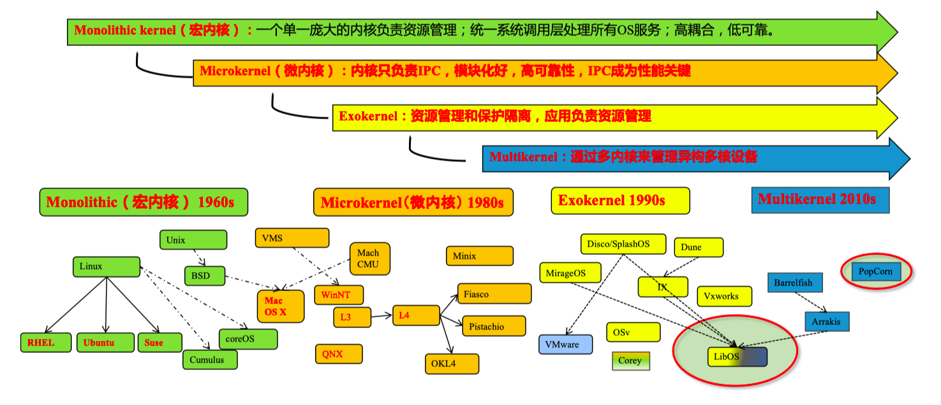
Operating System Evolving

Slide 7
Exokernel on X86: XoK & ExOS

Slide 8
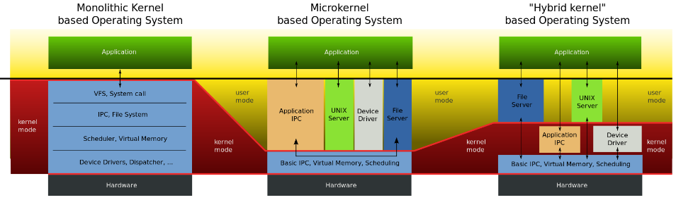
Comparison

Slide 9
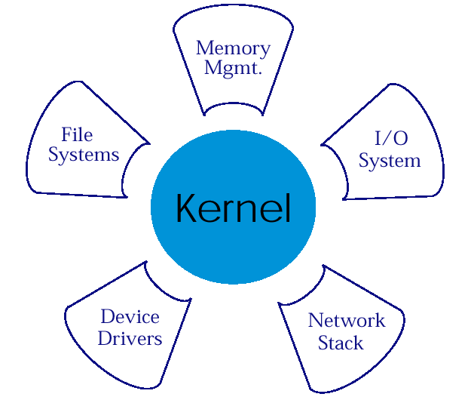
Micro-Kernel Structure & Instances
APP1
APPn
LPC
APP2
APP4
HAL
APP3

Slide 10
Traditional OS
Only privileged servers and the kernel can manage system resources
Both resource management & protection are done by kernel
Centralized control
Untrusted applications are limited to the interface
Limited functionality
Hurt application performance
Hide information (page fault etc.)

Slide 11
Traditional OS
An interface designed to accommodate every application must anticipate all possible needs
Flawed!
Solution:
Allow applications enough control over resources by separating protection from management
"Exokernel" does this
User process
User process
System calls
Kernel

Slide 12
Exokernel
Separates resource management from protection
Normal kernel does both
Kernel: only protect the resources
Application: manage the resources
Virtual memory, file system etc., are in application libraries
Gives untrusted software as much control over hardware and software resources as possible
Specialized applications can gain high performance without sacrificing the unmodified UNIX program

Slide 13
Specialization
Application specialization
E.g., millions of apps on phone
OS specialization
E.g., for server, desktop, phone, IoT devices, ...
Hardware specialization
E.g., CPU, GPU, TPU, NPU, DSP, SSE, ...

Slide 14
OS as a Library
"Unix as a library"
Can implement traditional OS abstraction
Most application programs will be linked to libOSes of their choices instead of communicating with the Exokernel
Unprivileged libraries
Can be modified or replaced at will
Different libOSes can coexist on the top of same Exokernel
Allows system to emulate behaviors of several conventional OSs

Slide 15
Comparison
OS
App
Logic
User-Mode
Kernel-Mode
DOS
UNIX
MicroKernel
ExoKernel
Notes:
Q1: what are difference? Consider file system, page fault handler, device driver, cpu scheduling
Q2: what is address space? Note that the kernel and apps share the same space
Q3: which one has the best performance
Q4: what is virtual machine's architecture? Both Xen and KVM

Slide 16
Exokernel Design Challenge
Kernel's new role
Tracking ownership of resources
Ensuring resource protection
Revoking resource access
Three techniques
Secure binding
Visible revocation
Abort protocol
Notes:
An Exokernel employs three techniques to export resources securely. First, by using secure bindings, applications can securely bind to machine resources and handle events. Second, by using visible resource revocation, applications participate in a resource revocation protocol. Third, by using an abort protocol, and exokernel can break secure bindings of uncooperative applications by force.

Slide 17
Secure Binding
It is a protection mechanism that decouples authorization from actual use of a resource
Can improve performance
The protection checks involved in enforcing a secure binding are expressed in terms of simple operations that the kernel can implement quickly
A secure binding performs authorization only at bind time, which allows management to be decoupled from protection
Three techniques
Hardware mechanism, software caching, and downloading application code
Notes:
First, by using secure bindings, applications can securely bind to machine resources and handle events.

Slide 18
Visible Resource Revocation
A way to reclaim resources and break their (application & resources) secure binding
An exokernel uses visible revocation for most resources
Traditionally, OS have performed revocation invisibly, de-allocating resources without application involvement
Dialogue between an exokernel and a library OS
Library OS should organize resource lists
Notes:
Second, by using visible resource revocation, applications participate in a resource revocation protocol.

Slide 19
The Abort Protocol
An exokernel must also be able to take resources from library operating systems that fail to respond satisfactorily to revocation requests
If a library OS fails to respond quickly, the secure bindings need to be broken "by force"
An exokernel simply breaks all secure bindings to the resource and informs the library operating system
Notes:
Third, by using an abort protocol, and exokernel can break secure bindings of uncooperative applications by force.

Slide 20
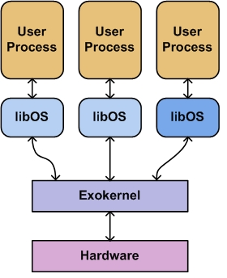
Exokernel: Example on Disk Management
Application manages its disk-block cache and kernel allows cached pages to be shared securely between applications
User space
Kernel space

Slide 21
Extensible OS
Extensibility lets new functionalities to be included in the OS
Let applications safely modify system behavior for its own need
Different approaches to extensible OS:
Exokernel (MIT)
SPIN (UW)
VINO (Harvard)
L4 (IBM)
Fluke/OSKit (Utah)

Slide 22
Exokernel's Memory Protection
Using software TLB
ExoKernel manages the TLB
libOS manages the page table
Using page table only
libOS can read but not arbitrarily write the page table
Page table itself is set as read-only
Modification or changing of page table will trap to ExoKernel
Software managed TLB: when there is a TLB miss, the CPU will trigger an exception and let the kernel to fill TLB, instead of doing so in hardware directly.

Slide 23
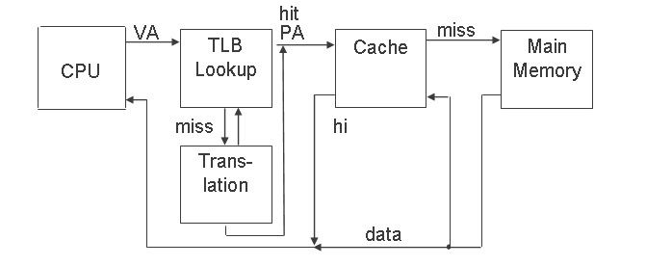
Review: TLB & Cache

Slide 24
Exokernel Principles
Separate resource protection and management
Exokernel and libOSes
Minimum resource management as required by protection (allocation, revocation etc.)
Expose allocation
Applications allocate resources
Kernel allows the allocation requests

Slide 25
Exokernel Principles
Expose names
Exokernels use physical names wherever possible
Expose revocation
Let application choose which instance of resource is to give up
Expose information
Expose all system info and collect data that application can not easily derive locally

Slide 26
Exokernel: Benefits
Exposing kernel data structure
Can be accessed without system call overhead
Flexibility
libOSes can be modified and debugged more easily
"Edit, compile, debug" cycle of applications is considerably faster than the "edit, compile, reboot, debug" cycle of kernel
Performance
Aggressive applications may gain speed up to 10x

Slide 27
Exokernel: Drawbacks
Exokernel interface design is not simple
Most of the major Exokernel interfaces have gone through multiple designs over several years
The ease of creation and mixing of libOSes could lead to code messes
nightmare for maintenance coders and system administrators
It is theoretically possible to provide libOSes that enable applications to run simultaneously on the same system, that would also mean different look & feels for each of them
Different libOSes may have varying levels of compatibility and interoperability
Poorly chosen abstractions may cause lose of information
Self-paging libOSes is difficult

Slide 28
Criticisms of Exokernel
Customer-Support:
"Extensibility has its problems. For example, it makes the customer-support issues a lot more complicated, because you no longer know which OS each of your customers is running" (Milojicic, 1999).

Slide 29
Linux as a LibOS?
Use Linux as a libOS or unikernel
E.g., LKL - Linux kernel library (https://github.com/lkl)
Change all the system calls to function calls
Offer certain compatibility, avoid re-implementation
New problems
Is Linux suitable to serve as a libOS/unikernel？
How to handle fork()?
Still in research stage

Slide 30
Summary
Exokernel Architecture:
Goal: safe application control of all resources
How: by separating resource management from protection
Results found promising:
Unmodified applications run same or 4x better
Customized applications can run up to 8x better
Global performance is similarly good like UNIX

Slide 31
Multi-Kernel

Slide 32
Multikernel
System on Chip
CPU
CPU
Multicore and Heterogenous cores
OS maintains many shared status
Cache coherence becomes harder
Scalability issues: more cores, less performance
More smart devices like GPU
Each device has its own core
Connected with PCIe, long latency and poor throughput
Connected with system bus, e.g., SoC（System on Chip）
GPU
NPU
PCIe
GPU

Slide 33
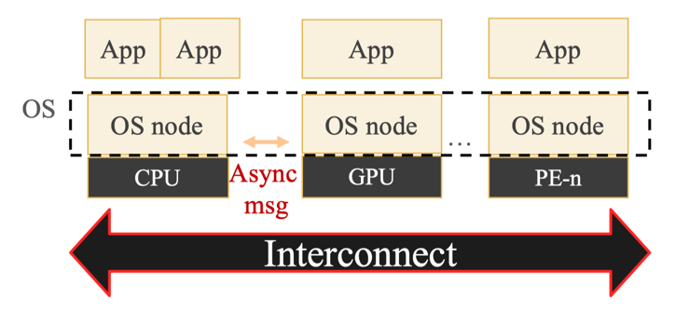
The Design of Multikernel
Multikernel's idea
The default configuration is partitioning, not sharing
Maintaining multiple copies, instead of one
Explicit communication between different cores
Multikernel design
One kernel per core
Including CPU, GPU etc.
OS works as a distributed system
Applications still run on OS

Slide 34
Barrelfish Multikernel
Barrelfish OS
From ETH Zurich and MSR
Support heterogenous CPU
Use message abstraction between CPU and devices
Around 10,000 C code and 500 assembly

Slide 35
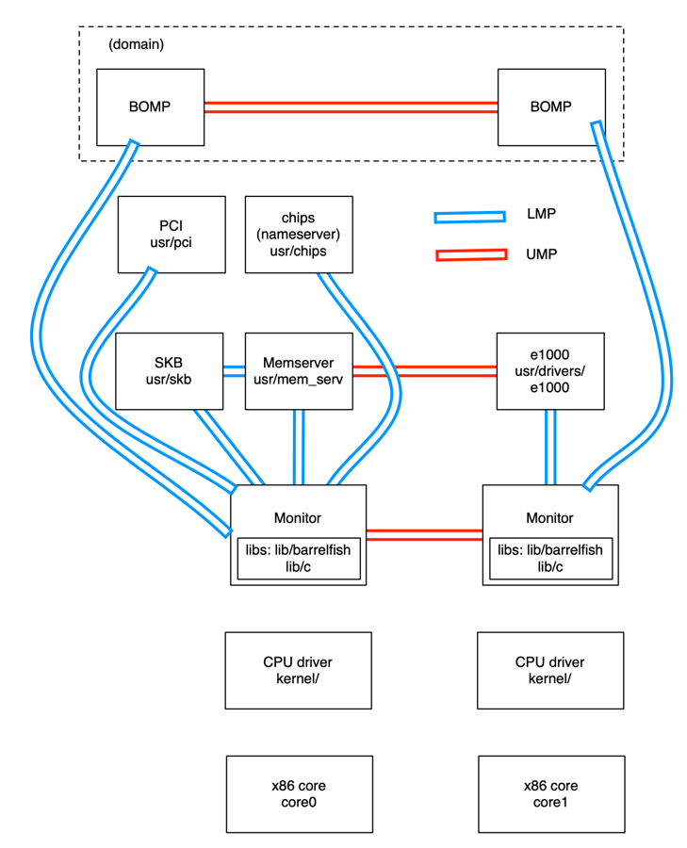
Barrelfish Structure
BOMP: Barrelfish OpenMP
Local Message Passing
Kernel: Per core
Like CPU driver, adapt to different CPUs
System call, interrupt/exception
Event-driven, single-thread
Uninterruptable
Schedules and runs the dispatcher
Dispatcher (like thread)
Multiple dispatcher becomes a Domain
Domain (like process)
User-level Message Passing
SKB: System Knowledge Base
类似 /proc
http://www.barrelfish.org/documentation.html

Slide 36
Popcorn Linux
Support multiple architectures
ARM, x86, etc.
Multiple Linux kernel replicas
With the same code
One replica per ISA
Offer OS services at the same time
http://www.popcornlinux.org/

Slide 37
Flex-SC
Flexible System Call Scheduling with Exception-Less System Calls, OSDI'10

Slide 38
The Motivation
How to further reduce the latency of syscall?
Not only for gettimeofday()
Where does the latency come from?
Mostly for the state switch
Save and restore states
Privilege checking
Cache pollution
Could we do syscall without state switching?

Slide 39
Flexible System Call
New syscall mechanism – Flexible System Call
Introduce system call page that is shared by user & kernel
User threads can push the system call requests into the system call page
kernel threads will poll the system call requests out the system call page
Exception-less syscall
Remove synchronicity by decoupling invocation from execution

Slide 40
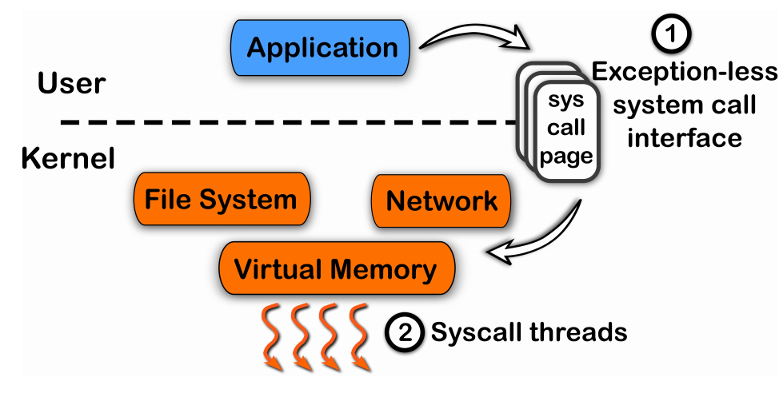
Another Way for System Call

Slide 41
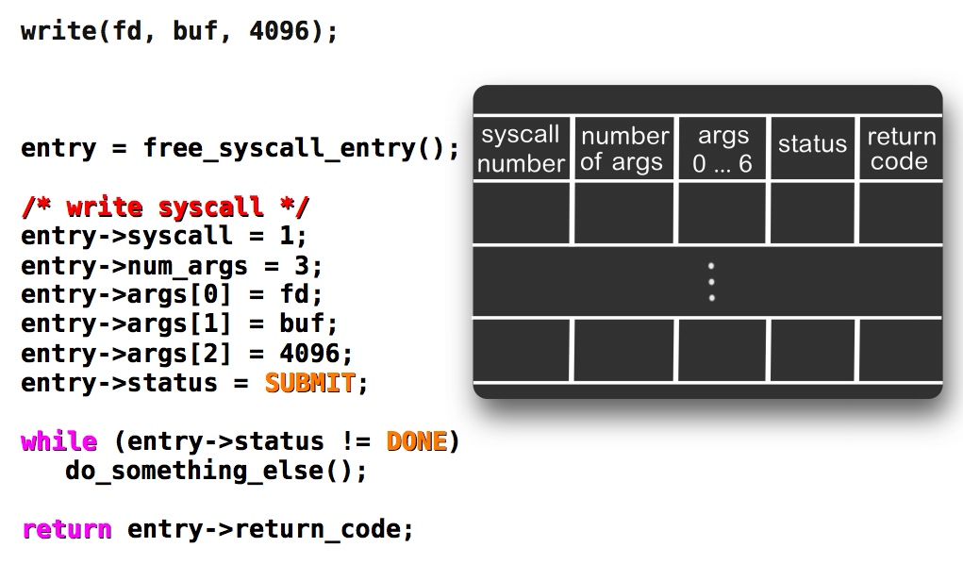
Exception-less System Call

Slide 42
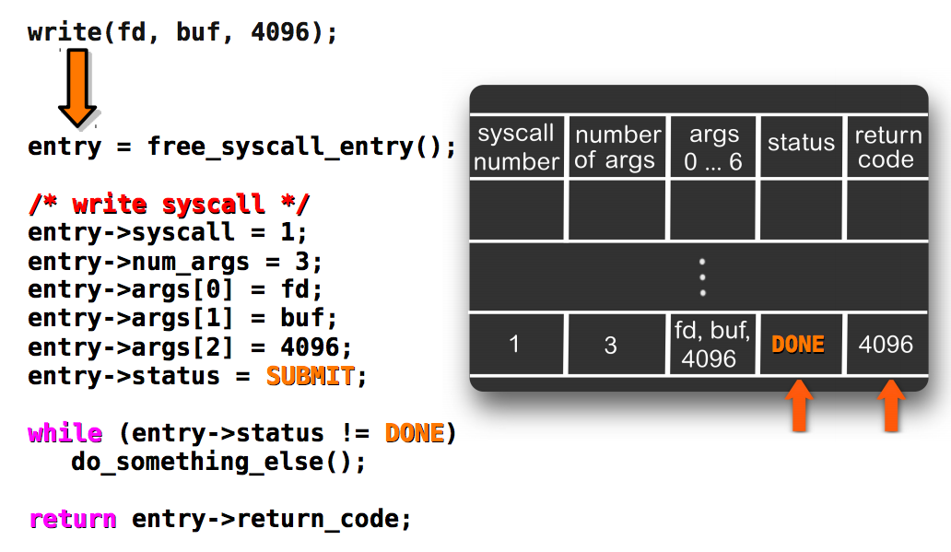
Kernel Fill the Results

Slide 43
On a Single Core: Single Threads
Application
Push system call
User
Kernel
Sys call page
Sys call page
Switch to user
Sys call page
Switch to kernel
a
b
c
d
Kernel threads
pull system call

Slide 44
On a Single Core: Multiple Threads
switch
switch
switch
user thread
user thread
user thread
user thread
user thread
user thread
user thread
user thread
Push system call
Sys call page
Push system call
Sys call page
Push system call
Push system call
Sys call page
a
b
User mode
Kernel mode
Switch to kernel
Switch to user
c
d
kernel thread
pull system call
FlexSC: Flexible System Call Scheduling with Exception-Less System Calls

Slide 45
Case: Xen
The art of virtualization

Slide 46
VMM: A Brief History
Virtual Machine Monitor: a software-abstraction layer that partitions the HW into one or more virtual machines
1960s: used for multiplexing the scarce general purpose computing platforms among multiple applications
1980s: multitasking OSes + low HW costs
Rendered VMMs obsolete
Consequently, no hardware support for virtualization in the CPU architectures of the time (e.g., x86)

Slide 47
Why This Revival?
Virtual Machine Monitor: a software-abstraction layer that partition the HW into one or more virtual machines
1960s: used for multiplexing the scarce general purpose computing platforms among multiple applications
1980s: multitasking OSes + low cost hardware
Rendered VMMs obsolete
2000s: multitasking OSes + low cost hardware
Revived VMMs

Slide 48
Challenges to Build Virtual Machines
Performance isolation
Scheduling priority
Memory demand
Network traffic
Disk accesses
Support for various OS platforms
Small performance overhead

Slide 49
Xen's Goals
Multiplexes resources at the granularity of an entire OS
As opposed to process-level multiplexing
Price: higher overhead
Target: 100 virtual OSes per machine

Slide 50
Xen: Approach and Overview
Conventional approach: Full virtualization
Cannot access the hardware
Problematic for certain privileged instructions (e.g., traps)
No real-time guarantees
Xen: Para-virtualization
Provides some exposures to the underlying HW
Better performance
Need modifications to the OS
No modifications to applications

Slide 51
Memory Management
Depending on the hardware supports
Software managed TLB
Associate address space IDs with TLB tags
Allow coexistence of OSes
Avoid TLB flushing across OS boundaries

Slide 52
Memory Management
X86 does not have software managed TLB
Xen exists at the top 64MB of every address space
Avoid TLB flushing when an guest OS enter/exist Xen
Each OS can only map to memory it owns
Writes are validated by Xen

Slide 53
CPU
X86 supports 4 levels of privileges
Ring-0 for OS, and ring-3 for applications
Xen downgrades the privilege of OSes to ring-1
System-call and page-fault handlers registered to Xen
"fast handlers" for most exceptions, Xen isn't involved

Slide 54
Device I/O
Xen exposes a set of simple device abstractions
One driver for each type of device
Network
Disk
Console
…

Slide 55
The Cost of Porting an OS to Xen
Privileged instructions
Page table access
Network driver
Block device driver
<2% of code-base

Slide 56
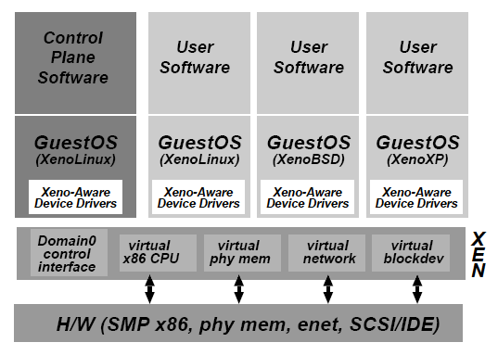
Control Management
Separation of policy and mechanism
Domain-0 hosts the application-level management software
Creation and deletion
of virtual network
interfaces and block
devices

Slide 57
Control Transfer: Hypercalls and Events
Hypercall: synchronous calls from a domain to Xen
Analogous to system calls
Events: asynchronous notifications from Xen to domains
Replace device interrupts

